Slide 1

Streams
Lecturer
Rokas Slaboševičius
Data

Slide 2
Today you will learn
Streams
What are streams?
FileStream
01
04
File class
02
StreamReader/StreamWriter
03

Slide 3
Stream
Streams
Stream is an abstract class that provides various options for working with bytes (e.g.: reading, writing).
There are different stream types, but today we will talk about the FileStream, StreamWriter, StreamReader classes.

Slide 4
Stream abstraction levels
Streams
Let's review the different levels of abstraction when reading from files.
Levels are listed in order of increasing complexity and control:
File class.
ReadLines() method of the File class.
StreamReader and StreamWriter classes.
FileStream class.

Slide 5
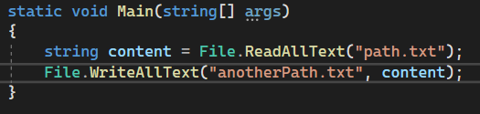
File class
Streams
The easiest and least efficient way is the File class with methods:
File.ReadAllText.
File.ReadAllLines.
File.WriteAllText.
File.WriteAllLines.
Benefits:
The easiest way to read or write from a file.
Minuses:
Reads/Writes all text at once, limited ability to control access to files, different encodings and buffering.

Slide 6
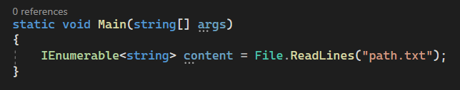
ReadLines with Lazy Evaluation of the file class
Streams
Slightly more complex, but much faster reading for larger files.
ReadLines returns IEnumerable returns yield, which means that when the method is run it will start reading the file and will immediately use the text returned in real time (returns are done on a line by line basis), so if you are iterating over a large file, the program doesn't have to wait for the File class to finish reading the file, it can just start reading the file immediately.
Benefits:
Lazy evaluation allows you to read one line at a time without loading the whole file into memory at once. Eventually the file will be read in full into memory, but you can terminate the code if you no longer need to read.
Minuses:
Anyway, the possibilities to control access to files or encodings are limited.

Slide 7
StreamReader and StreamWriter classes
Streams
As the names suggest, the StreamReader class is for reading from a file and the StreamWriter class is for writing to a file.
Benefits:
Easier reading of text files, automatic handling of different encodings, lazy evaluation reading, ability to change buffering settings.
Minuses:
More complex to use than the methods of the File class, mainly used to read text files.

Slide 8
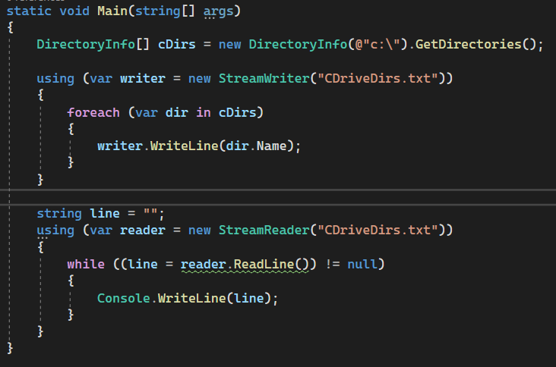
StreamReader and StreamWriter classes
Streams

Slide 9
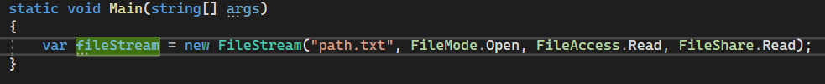
FileStream
Streams
The most sophisticated way to read files, and also the one with the most control:
Ability to specify the reader's permissions on a file (read/write)
Different buffering methods
File sharing
Exclusive access: nobody else can do anything to the file while this FileStream is using it.
Read sharing: other processes can read from the file, but cannot write.
Write sharing: other processes can write to the file but cannot read it.
Read/Write sharing: other processes can both read and write to the file.

Slide 10
Which one to choose?
Streams
If you need to read a small text file, choose methods of type File.ReadAllLines/File.ReadAllText
If it is a plain text file but the size is 100mb+ use File.ReadLines().
If the file is larger than 100 megabytes, or if it is not in text format, or if it is not in standard encoding, use StreamReader/StreamWriter
If you have an exceptional encoding, a large file, need to allow other processes to do something with the file at the same time and need complex read settings in general, use FileStream.

Slide 11

Streams
Task 1
Read the entire text file using the File.ReadAllText() method and print it to the console.
Write the contents of the List<string> list to the file, each item as a new string. Using File.WriteAllLines().
Copy the file from one location to another using the File.Copy() method.

Slide 12
Streams
Task 2
Read a large text file line by line and count the number of characters in each line. Use File.ReadLines()
Write to a file using the StreamWriter class, write both textual and numeric data.
Write the binary data to a file, try using BinaryReader and BinaryWriter

Slide 13
Streams
Task 3
Advanced, there will be unknowns from untapped topics:
Read a large file using a custom buffer size and see what difference it made to the file's reading performance.
Implement asynchronous file reading which does not block the main thread of the running application.
Implement a file-based caching system that will store key-value pairs in a file and allow them to be efficiently extracted or written. Use the FileStream class for efficient read control, potentially implementing indexing or other efficiency strategies.

